Slide 1
Slide 2: Definition of Acute Renal Failure
Slide 3 Classification of ARF
Slide 4-5 Cause of ARF
Slide 6 Phases of ARF (S/S)
Slide 7 Monitor

Slide 2
Acute Renal Failure: Abrupt and sustained decrease in renal function
Check SCr if pt has
ARF (acute renal failure)
SCr 0.6 – 1.2
Baseline
SCr < 2.5 mg/dL
Baseline
SCr > 2.5 mg/dL
Normal
If Increase by
0.5 mg/dL
If Increase by
1 mg/dL
Then pt has
ARF
Then pt has
ARF
Classify ARF on next slide
Notes:
http://surgvideo.surg.sunysb.edu/Volumes/ACS+Oct+2010/ACSCD/figures/ch0807-f1.htm

Slide 3
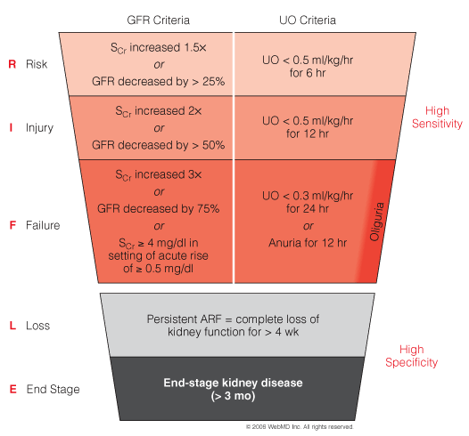
RIFLE (Risk, Injury, Failure, Loss, End stage) classification scheme for ARF.
Patients can be classified either by GFR criteria or by UO criteria. Whichever is worse

Slide 4
3 Causes of ARF:
Pre-Renal: inadequate blood flow to the kidneys known as Hypoperfusion
Cause | Example
Decrease in Blood Volume | Hemorrhage
Volume Depletion | Diuretics Burns
Ineffective Arterial Volume | CHF Ascites: accumulation of fluid in the peritoneal cavity
Hemodynamic (movement) | NSAIDS, ACE-I
3) Post-Renal Failure: Outflow Obstruction in the urinary tract
Cause | Example
Physical obstruction | Prostate, tumors, renal calculi (kidney stones)
Drugs | Urinary Caliculi aka kidney stones: Triamterene (K sparing diuretic) Indinavir (PI for HIV)

Slide 5
3 Causes of ARF:
3) Intrinsic Renal Failure: problem with the kidneys
Cause | Definition
Vasculitis | inflammation of vessels
Acute glomerulonephritis | Inflammation of glomerular
Interstitial nephritis | Space between kidney tubules become inflamed
Acute tubular necrosis (ATN) | Slide 9-12

Slide 6
3 Phases of ARF
 | S/S | Definition
Phase 1 | Urine Production 50-500-1000 | Normal Production > 1000 mL/day Non-Oliguric failure 400 – 1000 mL/day Oliguria Production 50 – 400 mL/Day Anuria Production < 50 mL/day
Phase 2 | Diuretic Phase | Period of Increased Urine production
Phase 3 | Recovery Phase | Can take weeks to months

Slide 7
Monitor
BUN (Blood Urea Nitrogen) | Values
Normal BUN | 10 – 20 mg/dL
Normal BUN : Creatinine Ratio | 10 : 1
Pre-Renal BUN : Creatinine Ratio | > 20 : 1 (increase in BUN)
Specific Gravity of Urine | Values
Normal | 1.000 - 1.030.
Pre-Renal Azotemia level | > 1.020
Protein-uria
Hemat-uria
Eosinophils

Slide 8
Nephrotoxic Dietary Supplements
Aristolochic Acid
L-lysine: ATN
Pennyroyal: ATN
Thunder god vine: ? Hypotensive shock
Vitamin C: Crystalluria
Willow Bark: refer to NSAIDs
Wormwood oil: ARF secondary to rhabdomyolysis
Yellow oleander: ATN

Slide 9
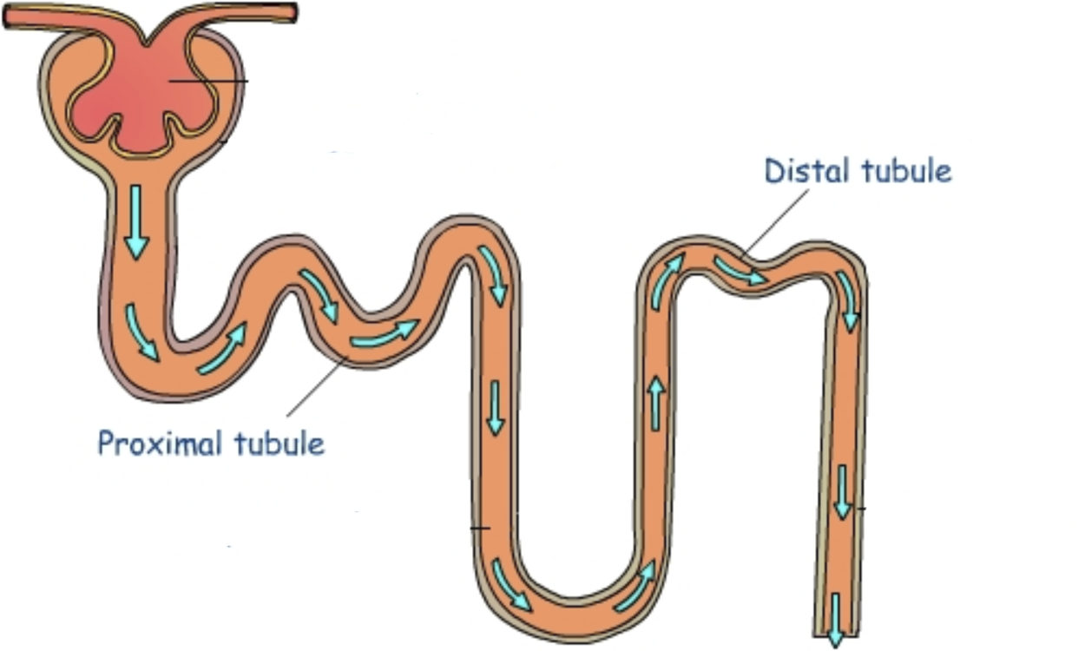
Drug Induced Nephrotoxicity damages Proximal and distal tubules
Metabolic Acidosis
Can’t concentrate Urine
hyPERkalemia
Metabolic Acidosis
Bicarbonate
Glycosuria
Electrolytes
Hypophosphatemia
Hypouricemia
Hypokalemia
Hypomagnesemia

Slide 10
Antibiotics that cause Nephrotoxicity
Drug | MOA | Labs | Prevent toxicity
Aminoglycosides Trough must be < 2 mg/L | Drug gets taken up into cell → Proximal tubular epithelia cell damage from lysosomal enzymes | Decrease GFR SCr < 500 mL urine | Worse to Best 1. Neomycin 2. Genta & Tobra 3. Amikacin 4. Streptomycin
Colistimethate Polymyxin antibiotic | Increase membrane permeability → Influx of ions → influx of water Colistimethate is a prodrug of Colistin 400 mg Colistimethate = 150 Colistin |  | Written ONLY for Colistin
Amphotericin | Direct tubular Epithelia Cell toxicity Renal Arteriole Vasoconstriction |  | Salt Load 1 L NS
Vancomycin Tough must be < 15 mg/L | Not a major nephrotoxin

Slide 11
Anti-Vials that cause Nephrotoxicity
Drug | MOA | Labs | Prevent toxicity
Foscarnet Tx CMV infection | 65% of pts WILL develop nephro | Electrolytes | Hydration
Tenofovir for HIV (Truvada) (Atripla) | Binds to hOAT1 anion transporter in proximal tube. Tenofovir induced Fanconi Syndrome substances that should be absorbed is eliminated instead: Tubular Acidosis Phosphate → affects bone Hypokalemia | Low uric acid Low bicarb Low glucose Low phosphate Low AA
Notes:
Fanconi syndrome is a disorder of the kidney tubes in which certain substances normally absorbed into the bloodstream by the kidneys are released into the urine instead

Slide 12
Drug | MOA | Labs | Prevent toxicity
ACE-I ARB | Increase vasodilation of efferent arteriole | BUN SCr hyPERkalemia | Tx hyPERkalemia Start low dose
NSAID | Prostaglandin vasodilate renal NSAIDS Inhibit Prostaglandin dependent renal blood flow (vasoconstriction) | Decrease GFR | APAP Non-acetylated salicylates
Notes:
ADH conserves water

Slide 13
Drug | MOA | Labs | Prevent toxicity
Radio Contrast | Direct tubular cell toxicity Increase Oxygen free radicals hyperosmolarity |  | Saline hydration: 12 hours before 12 hours after
Cyclosporine | Decrease Acute renal transplant rejection, not chronic. Interstitial nephritis | Increase SCr Decrease CrCl Hyperkalemia
Dextran Mannitol PEG | Osmotic Nephrosis from renal swelling

Slide 14
ADH conserves water. Too much ADH = fluid overload
Syndrome of inappropriate antidiuretic hormone secretion (SIADH): is characterized by excessive release of antidiuretic hormone from the posterior pituitary gland or another source. The result is hyponatremia and sometimes fluid overload
Note: Hormone is off balance. NOT kidneys (normal renal function, adrenal and thyroid)
Drugs that cause SIADH | MOA
SSRI Or Carbamazepine | Stimulates ADH from hypothalamus Onset 1-3 weeks after initiation
Sulfonylureas - DM2 Glipizide, glyburide | SIADH Most common with chlorpropamide Stimulate ADH
Drug to Tx SIADH | MOA | Notes
Demeclocycline | Antibiotic | Off label or SIADH
Conivaptan | Vasopressin Inhibitor | Substrate of CYP3A4

Slide 15
Diabetes Insipidus (DI): is a condition characterized by excessive thirst and excretion of large amounts of severely diluted urine, with reduction of fluid intake having no effect on the concentration of the urine.
Central Diabetes Insipidus: Deficiency in ADH release
Nephrogenic Diabetes Insipidus: Kidney has inability to respond to ADH
Central Vs Nephrogenic DI
Give Vasopressin (ADH). If urine increases in osmolality, then pt has Central DI
Drug induced DI
Lithium: Accumulation of Li in collecting tubule cells through Na channels. “Takes over Na”
Treatment: HyPOtonic Saline (avoid hypernatremia)
Dialysis
Amiloride: potassium sparing diuretic by closing Na channels
Amiodarone
Amphotericin
Cidofovir
Colchicine
Demeclocycline

